Slide 1
Fear Learning: The Interworking Circuits that Affect Fear
By: Cami Brenner

Slide 2
Fear Learning
Usually thought to occur in the amygdala
Long term potentiation leads to a synaptic plasticity
Known as learning
A learned fear can be common in disorders related to stress/fear
Fearful response still exists even when fear is gone

Slide 3
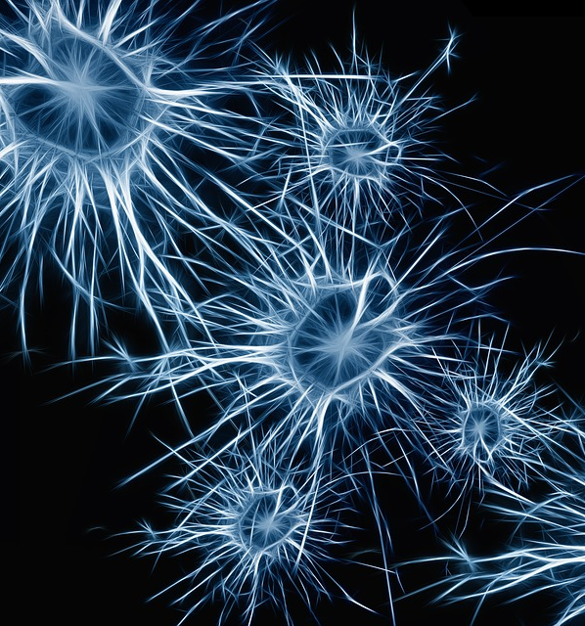
Interneurons Circuits
Interneurons transmit pulse between other neurons
Look at creating reflex arcs
The brain is complex
Each interneuron is useful in its own set of connections
Clinically important
Where do these nerons fit into chronic disease?
How is fear learning important in each of these diseases?

Slide 4
Clinical Application
PTSD
Social Phobias
Depression
Prolonged Anxiety
This Photo by Unknown Author is licensed under CC BY-SA

Slide 5
Overarching questions
Can neural gene transfection use interneurons to help treat chronic diseases/disorders?
PTSD
Diagnosis
Will understanding circuitries of neurons help pharmacological approaches to correctly treat these stress disorders?
Can you use these specific neurons to treat these disorders?

Slide 6
Gillet Paper

Slide 7
Contributions to Fear Learning
1-induction of auditory fear learning
Projections from Auditory cortex to amagdyla
2- Fear Conditioning enhances response to conditioned tone
Neurons in auditory cortex show enhanced response to conditioned tones immediately after fear conditioning
1+2= Cortical Plasticity that contributes to fear learning

Slide 8
Background
-amagdyla: important in associative fear conditioning
Neural circuits (sensory cortex): important for acquisition and expression of learned fear
Removal or inactivation of auditory neural cicruits creates impairment of retrieval of fear memories
This is not understood
Related to complex auditory system?
Related to neural circuitry?
Related to conditioning protocol?

Slide 9
Questions
What is the role of auditory cortex in retrieval of fear memory?
How does fear learning regulate cortical sensory presentations?
How is neural plasticity contributing to these ideas?
Proposal: Changes in cortical sensory representation contributes to memory strength or stimulus discrimination
However, small number of neurons show learning related change in activity

Slide 10
Research
Used optogenetic silencing combined with two photon calcium imaging in mice (during auditory cortex of fear learning)
Optogenic activation of GABAergic interneurons
Two photon calcium for imaging in primary auditory cortex of awake mice
Considers cortical sensory representations before and after discriminative fear learning

Slide 11
Procedures
Mice-housed in room with reversed light cycle
Experiments performed during dark period
Mice suited with stainless steel head bar to skull
Muscle that overlies right auditory cortex removed
Small Craniotomy was made (dura intact, 2x3 mm)
Sealed with 1.5% agarose
Injected with virus (10-16 locations)
Imaging occurred 3-7 weeks following virus injection

Slide 12
Viral Infections
mice heterozygous for GAD2- Cre and Rosa-LSLtdTomato
AAV 2/9-syn-GCaMP6s
mice heterozygous for PV-Cre or SOM-Cre and Rosa-LSL-tdTomato
AAV 2/9-syn-FLEX-GCaMP6s

Slide 13
Discriminative Fear Learning: Head Fixed Mice Trained to Obtain Water at a Lick Port
After head bar implant
Dehydrated to no more than 80% of free drinking weight
Handled daily
Habituated to head fixation in sound attenuating enclosure (5-14 days)
Learning measured used licks per second (fear induced suppression of licking)
CS+ is a mouse that is presented with a tone and with a tail shock
CS- presented with the tone
Ran over 4 days
Day 1: four preconditioning trials
Day 2/3: conditioning with 10 trials
Day 4: Combined with optogenetic led illumination
Retrieval, habituation

Slide 14
Optigentics
To test role of auditory cortex in fear memory:
Expressed channelrhodopsin 2 (ChR2) in cortical GABAgeric interneurons
Precise temporal control of cortical activity on trial by trial basis of each invidual mouse
Unilateral cortical LED illumination applied during presentations of the tone on the day of memory retrival

Slide 16
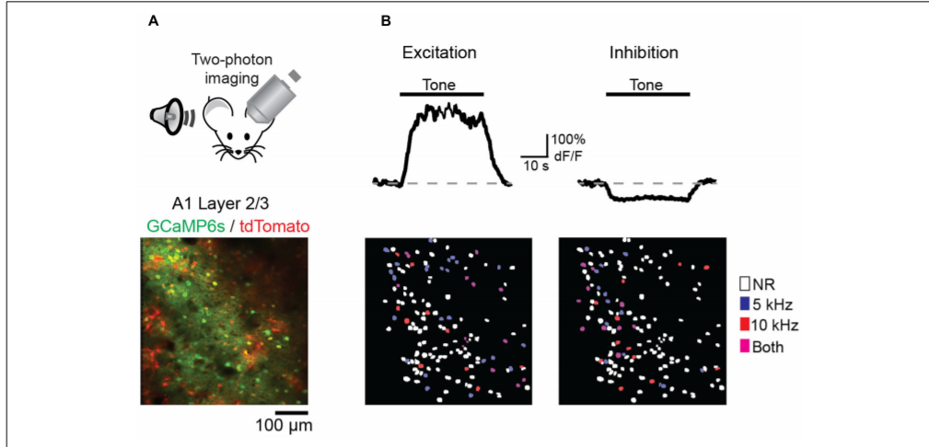
To determine impact of discriminative fear learning with conditioned tones in auditory cortex AAV Vector GCaMP6 ( contains GAD2-IRES-Cre × Rosa-LSL-tdTomato)-Calcium activity dependent

Slide 18
Notes:
.

Slide 19
Perceptual acuity can be modulated by fear learning that involves cortical circuits

Slide 20
Considered that changes in interneuron activity can create/influence effects of fear conditioning on pyramidal cell activity
Considered 2 main cortical Gabaergic neurons: paravalbumin (pv) and somatostatin (Som)
used conditional expression of GCaMP6s in PV-cre and SOM-cre mice

Slide 22
Conclusions
Discriminative fear learning modulates cortical sensory representations via suppression of cortical habituation
Auditory Cortex has critical role in discriminative fear learning
CS- representations are reduced following fear conditioning
Decline due to habituation
Could be due to inhibitory circuits contributing to induction of auditory fear learning
CS+ representations are maintained

Slide 23
Conclusions
Amygdala: receives sensory information from both auditory thalamus and auditory cortex
Fear conditioning can be mediated by either pathway
Auditory Cortex involvement is likely dependent on intricacy of stimuli
Optogenetic cortical inactivation did not block fear expression when learning was based on a simple fear conditioning protocol.
Cortical silencing disrupted fear memory retrieval during discriminative fear learning

Slide 24
Conclusions
Sensory representations are bidirectionally modified based on the behavioral relevance of sensory stimuli.
Discriminative fear conditioning leads to a selective increase in SOM cell activity to CS− but not CS+ tones
Results indicate that discriminative fear conditioning regulates cortical sensory processing by preventing habituation
Cortical representations of valued sensory stimuli are retained while representations of stimuli lacking relevance can be reduced

Slide 25
Zhou Paper

Slide 26
Research into Cellular and Molecular Mechanisms of Memories
Encoding and recall do not occur in the same condition
CA1 Regions have been shown to be important in memory and generalization
Overgeneralization occurs with PTSD
Means this research could potentially affect these neural fields

Slide 27
Questions
Are CA1 regions, and which, local, separate mechanisms are involved following memories?
How does generalization occur from original memories?
Does the hippocampus learn quickly enough to interact with cortical system, that then creates the elements of memory for generalization?
Can and how do Hippocampal CA1 regions process fear memory and generalization through recruitment of other regions?

Slide 28
Background
Memories include activity-dependent fast changes in CA3-CA1 synapses as a key mechanism
medial prefrontal cortex (mPFC) controls generalization of contextual fear memory during acquisition (via the nucleus reuniens of the thalamus)
signals to the hippocampus and also back to the mPFC

Slide 29
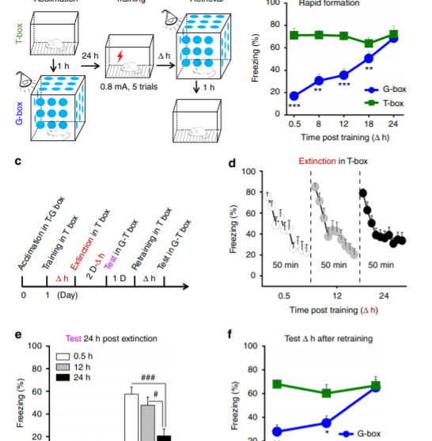
Methods
Rats were placed into a non-training box (G-box blue)
0.5, 1, 8, 12, and 24 hours later rats were placed into training box (T-Box green)-Figure 1A
After fear conditioning occurred
Notes:
Figure 1b:As shown in Fig. 1b, fear memory was formed quickly in T-box, and maintained over the retrieval tests. By contrast, generalization was developed gradually in G-box, and rapidly rose up to maximal over 24 h, when recall efficiency became near equivalent to that in T-box, shows rapid time course of generalization of full formation distinct from that of fear memory
To show how this rapid generalization was occurring and its mechanisms, generalization and fear memory 24 h after extinction training that was performed by exposing the rats into T-box for 50 min (Fig. 1c), starting at 0.5, 12 or 24 h after fear conditioning for the separate groups (Fig. 1d, Δ h). These time points represented increasing levels (low to high) of generalization that was then maintained for at least 7 d, shows that early stages have nonsignificant effect on early stages if extinction training occurred, but later point showed largely reduced feat memory (suppression), the middle disrupted the generalization-reveals a distinct pattern in rapid generalization in memory extinction, retrinaing after caused gradual generalization reformation over 24h, proposes that circuit mechanism for rapid gernalization is separate from fear memory (could still share molecular and chemical processes)

Slide 30
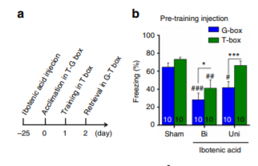
Circuit Mechanism of Rapid Generalization
Ibotenic Acid used to lesion CA1 region of dorsal hippocampus
Before fear conditioning (Figure A)
Showed unilateral CA1 lesion might impair generalization without affecting fear memory (24 hours after fear conditioning)
Showed bilateral CA1 lesion might impair both generalization and fear memory (24 hours after fear conditioning)

Slide 31
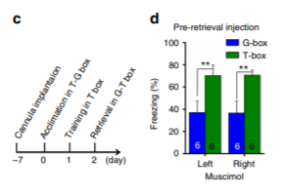
Inhibited CA1 with CNQX (AMPA blocker) + TTX( Na+ channel blocker)
Blocked GABA receptor through muscimol and anisomycin (known to impair long-term contextual fear memory)
Notes:
Unilateral or bilateral CA1 inhibition using CNQX + TTX before fear conditioning (Supplementary Fig. 2a, b) or before retrieval test (Supplementary Fig. 2c, d, CNQX + TTX) resulted in similar effects on generalization, RV-dG-GFP CA1 CA1 RV-dG-Dsred Recorded CA1 CA1 Stimulated 593 nm 593 nm 100 593 nm ON G-box T-box *** ## ## ### 80 60 40 20 9 9 10 EYFP Bi Uni NpHR 10 10 10 0 AAV-CaMKlla-NpHR3.0-EYFP AAV-CaMKlla-NpHR3.0-EYFP Virus injection & optic fiber implantation Acclimation in T-G box with optic fiber Training in T box Retrieval in G-T box Freezing (%) 100 G-box T-box ** # # # 80 60 40 20 10 10 10 EGFP Bi Uni TetLC 10 10 10 0 Freezing (%) NpHR expression CA1 fEPSP 1 2 3 0.6 mV 8 ms 15 10 5 Time (ms) 9 22 0 1 2 3 CA1 CA1 1 23 –30 0 1 2 (day) 593 nm Recorded Stimulated fEPSP (off %) CA1 CA1 * T2 T1 T2: CA1 to CA1 T2 T1 (10 ms) 0.5 mV 10 ms (8 ms) ΔT (2 ms) T1: CA3 to CA1 Virus injection Acclimation in T-G box Training in T box Retrieval in G-T box Virus injection Acclimation in T-G box with optic fiber Training in T box Retrieval in G-T box –30 0 1 2 (Day) –30 0 1 2 (Day) 100 140 1 3 OFF ON 0.5 mV 8 ms 2 4 120 OFF 1 2 3 4 ON OFF ON 100 80 n = 6 60 0 20 593 nm ON * # # G-box T-box 593 nm OFF 40 60 80 Time (min) 80 60 40 20 EYFP NpHR 8 8 8 8 8 8 Freezing (%) Dsred + GFP + DAPI Left GFP + Dsred + DAPI Dsred + GFP + DAPI GFP + DAPI Dsred + GFP Left Right Right Right Left Left Dsred + DAPI GFP + Dsred CA1 CA1 CA1 CA1 CA1 CA1 Right a b c e d f g h i j k l m n Fig. 3 The ipsCA-conCA1 functional connectivity. a RV-dG-GFP and -Dsred were infused into the stratum oriens of left and right CA1, and a number of neurons were labeled in the opposite side. b In vivo study revealed that electrical stimulation at ipsCA1 evoked the excitatory postsynaptic potentials (fEPSP) in conCA1, with an onset latency of about 8-ms (c, d T2), relative to about 10-ms in the CA3-CA1 pathway (c, d T1). e Paradigm for studying TetLC effects. f Unilateral (Uni) or bilateral (Bi) CA1 expression of TetLC (AAV-Syn-EGFP-2A-TetLC-3flg) impaired generalization or the both, respectively. g–j NpHR was expressed and optogenetic stimulation was used during the retrieval tests. Silencing of Uni or Bi CA1 impaired generalization or the both, respectively. k–n When NpHR was expressed at ipsCA1 but optogenetic stimulation was applied at conCA1 to silence the ipsCA1 projection terminals onto conCA1, the ipsCA1–conCA1 fEPSP was reduced by about 20% with light on relative to light off. Light on during the retrieval tests impaired generalization, while light off during the tests had a slight enhancement effect on
Unilateral or bilateral CA1 inhibition using CNQX+TTX before fear conditioning (fig 2a) or before retrival test (2c, d) resulted in similar effects in generalization examined 24 h after fear conditioning. Using muscimol before retrieval test to inhibit unilateral or bilateral CA1 also led to similar effects (Supplementary Fig. 2c, d, Muscimol). The drug effects on generalization were long-lasting, because either CNQX + TTX or anisomycin infused into unilateral or bilateral CA1 after fear conditioning impaired generalization or the both, tested 7 d after fear conditioning (Supplementary Fig. 2e, f). Thus, generalization appears to be a type of memory not only depending on but also differing from the original memory.

Slide 32
Examined if left or right CA1 regions were symmetrically required for generalization
Injection of muscimol to inhibit left or right before retrieval tests led to identical results (impairs generalization)
Unilateral lesion of dorsal hippocampus has no effect on contextual fear memory
Generalization requires bilateral CA1 activity
Means that dorsal hippocampus commissure is critical (DHC)
Highly preserved in mammals
Believed to be functional in humans as well

Slide 33
Notes:
bilateral CA1 activity is indeed symmetrical for generalization, we applied a single-foot fear conditioning paradigm by giving footshocks directly to the right hind leg of the rats

Slide 34
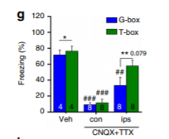
Pre-training inhibition
inhibition of conPIL using CNQX + TTX before single-foot fear conditioning impaired both fear memory and generalization
inhibiting ipsPIL impaired generalization with smaller nonsignificant effect on fear memory
these findings indicate that both sides communicate in the PIL, to be responsible for both fear memory and generalization
Notes:
bilateral CA1 activity is indeed symmetrical for generalization, we applied a single-foot fear conditioning paradigm by giving footshocks directly to the right hind leg of the rats
). It is documented that spinal cord neurons relay the signals of the footshocks to the posterior intralaminar nuclei (PIL) of the thalamus predominantly via contralateral projections19,20, and then to the hippocampus21. Therefore, we examined whether and how PIL inhibition could affect fear memory and/or generalization

Slide 35
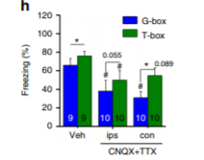
After-training inhibition
inhibition of ipsCA1 or conCA1 using CNQX + TTX after single-foot fear conditioning or before retrieval test similarly impaired generalization
ipsPIL responsible for generalization, is somehow emerged into a symmetry in which bilateral CA1 is responsible for generalization while unilateral CA1 is sufficient for fear memory.
For fear learning to occur, contralateral input should occur before training
For generalization, contralateral input occurs after the fear learning

Slide 36
Generalization Recap:
Depends on
Bilataerl CA1 activity
Requires symmetrical ipasCA1 activity and conCA1 activity (even in single foot response)
DHC could provide a route for interhemispheric exchanges between ipsCA1 and conCA1 to lead to such symmetry in CA1.
Pathway was reported to have only weak bilateral connections

Slide 37
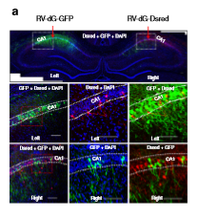
Reexamining CA1 bilateral connectivity
Used rabies virus (RV-dG-GFP and –Dsred, non-transsynaptic tracing virus)
Injected into ipsCA1
Number of neurons were found in conCA1, showing that neurons have projection terminals on ipsCA1
Injected into ipsCA1 again
Number of neurons were found on the opposite conCA1, showing that neuron might directly cross corpus collosuem midline
Notes:
Figure 4-suggesting that the labeled neurons have projection terminals onto ipsCA1 stratum oriens

Slide 38
RV-dG-GFP injected directly into midline
Even conncetions between ipsCA1 and conCA1
Covered bilateral CA1 region as a whole
RV-dG-GFP injected into ipsCA1 stratum
Neurons found in ipsCA3 and conCA3, but not CA1
ipasCA1
Receives bilateral input of CA3 at stratum
Can only sense conCA1 at stratum

Slide 39
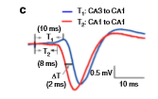
Characterizing ipsCA1-conCA1
Ample projection terminals found in conCA1 stratum (after infusion ofAAV-CaMKIIa-ChR2-EYFP into ipsCA1)
Optogentic stimulation caused excitatory postsynaptic potentials in conCA1
Electrically stimulating at the midline below the corpus collosum
Caused a EPSP in both ispCA1 and conCA1
Shows that ipsCA1-conCA1 is in the dorsal part of the hippocampus
10 ms transmission
Ca1-Ca1 connection is rapid

Slide 40
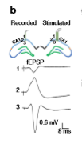
In vivo: EPSP at conCA1, 8ms, can be caused by stimulating ipsCA1 (b)
Used CNOX+TTX to rule out that excitatory stimulation was ipsCa3 driving conCA1
ipsCA1–conCA1 EPSP was blocked by infusion of CNQX+TTX into ipsCA1, but not into ipsCA3
Results show ipsCA1-conCA1 connection may sense bilateral CA1 activities
Function unclear still

Slide 41
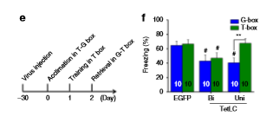
ipsCA1–conCA1 functional connectivity
Is this important for generalization, but not fear memory?
Injected AAV-synEGFP-2A-TetLC into CA1 30 d before fear conditioning (Fig. 3e) to express tetanus toxin light chain (TetLC), which blocks neurotransmitter release at the CA1 efferent projection terminals.
Unilateral CA1 expression of TetLC impaired generalization (F), but bilateral CA1 expression of TetLC impaired the both (Fig. 3f) relative to control virus
Suggests that CA1 efferent projections responsible for generalization

Slide 42
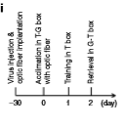
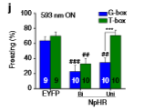
Direct silencing unilateral or bilateral CA1 neurons during retrieval produced similar results (expressed optogenetic AAV-CaMKIIa-NpHR-EYFP)
AAV-CaMKIIa-NpHR-EYFP injected into ipsCA1, optogenetic stimulation applied at conCA1
ipsCA1–conCA1 EPSP was reduced by about 20% with light on relative to light off
Generalization might be impaired with optogentic stimulation, but nonsignifcant effect on generalization during retrival tests

Slide 43
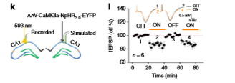
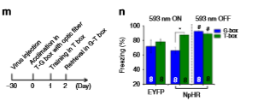
When signal is on, there is a reduction in generalization
Ipsilateral to contralateral Ca1 is important to generalization
a slight enhancement of both fear memory and generalization was observed by turned off the stimulation relative to EYFP control
activities of the ipsCA1–conCA1 projections were found to be particularly essential for generalization.

Slide 44
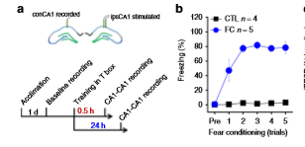
ipsCA1-conCA1 circuit and generalization
recorded experience-dependent changes of synaptic efﬁcacy in the ipsCA1–conCA1 circuit in freely moving rats. (a,b)
EPSP baseline was recorded for 40-min before fear conditioning

Slide 45
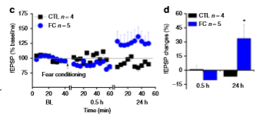
EPSP was recorded for 1h starting at 0.5h after fear conditioning. No difference from BL was detected at 0.5h after fear conditioning
generalization was nearly undetectable
By contrast, the EPSP recorded at 24h after fear conditioning exhibited a reliable synaptic potentiation relative to
generalization was well developed

Slide 46
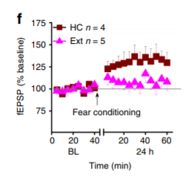
Extinction training strats at 0.5 h after fear conditioning disrupted fear memory
No effects on fear memory
No excitatory response
Extintion can prevent generilizatino

Slide 47
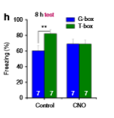
Are generalization and gradual developing synaptic potentiation causally linked together?
direct exciting of the ipsCA1–conCA1 synapses may speed up the active process for generalization formation
AAV-hsyn-hM3DqmCitrine that was injected into ipsCA1 (To excite these synapses continuously for hours, allowed for synaptic potential to be controlled)
Used injection of clozapine-N-oxide (CNO) twice, immediately after fear conditioning and 30min before retrieval tests at 8h (into conCA1)
excited the postsynaptic neurons that had the contralateral inputs
Generalization was facilitated, up to maximal levels already at 8h after fear
Without CNO treatment, generalization was signiﬁcantly lower
Shows that CNO impact generalization

Slide 48
Conclusions
Hippocampal CA1 regions are used in both fear memory and generalization
How do they function without interference?
spatiotemporally separated mechanisms within CA1 (at least in the early stage of memory processing)
CA3 neurons send commissural projections mainly onto synapses in stratum of ipsCA1 and conCA1,
Generalization is dependent on symmetrical ipsCA1–conCA1 activity,
maintained by gradual developing potentiation of synaptic efﬁcacy in the ipsCA1–conCA1 circuit.
fear memory is widely believed to involve fast potentiation of synaptic efﬁcacy in the synapses from CA3 to CA1
Generalization is gradual developing
Sensitive to extinction training

Slide 49
Conclusions
“hypothesis for which the formation of generalization is gradual but have actively rapid and passively slow phases, likely corresponding to cellular consolidation and systems consolidation of memory when the contextual components are more or less speciﬁc”
“This explanation seems consistent with clinical recommendation that exposurebased therapy early after trauma in susceptible individuals may produce better efﬁcacy in reducing overgeneralization of conditioned fear and prevalence of PTSD”

Slide 50
Conclusions
Fear memory is processed by contralateral sides of amygdala or thalamus (during fear conditioning)
Fear memory is likely duplicated in bilateral CA1 regions so that either CA1 is sufﬁcient for speciﬁc recall
Generalization requires symmetrical activity of bilateral CA1
Selection of which CA1 could be due to hippocampal activity
Sycroizes ipsCA1 and conCA1 at an early stage creates functional connectivity in bilateral CA1 neurons
Enables effective generalization formation at rapid phase

Slide 51
Conclusions
Gradual internal learning is continuously readjusting the functional connectivity of the neural circuits not only for minimizing interference but also for reducing unpredicted errors under varying circumstances.
Suggest that rapid generalization requires “gradual internal learning” over 24h (dependent on bilateral CA1 activities to readjust the interhemispheric CA1–CA1 synaptic efﬁcacy for the selective formation and also extinction of generalization)

Slide 52
Conclusions
Fear memory is quickly learned
Generalization develops over a 24 hour period
Impaired by inhibiting ipsilateral (ips) or contralateral (con) CA1, and by optogenetic silencing of the ipsCA1 projections onto conCA1
in vivo fEPSP recordings reveal that ipsCA1–conCA1 synaptic efficacy is increased with delay over 24 h when generalization is formed but it is unchanged if generalization is disrupted
Direct excitation of ipsCA1–conCA1 synapses using chemogenetic hM3Dq facilitates generalization formation
Rapid generalization is an active process dependent on bilateral CA1 regions, and encoded by gradual synaptic learning in ipsCA1–conCA1 circuit

Slide 53
Abs paper

Slide 54
Questions
How are the process of sensory input in the neoctorex encoded, based on behavioral relevance?
1
How is behavioral relevance encoded, integrated, and understood within the L1 circuity?
2
L1 circuity has not been able to be understood because of lack of selective genetic access
3
Cannot understand circuit or behavioral function of these specific INs

Slide 55
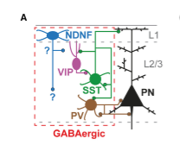
Background
Layer 1 (L1): in the neocortex
Contains few somata
Comprised of apical dendrites of local pyramidal neurons (PNs)
Have long projections to convey contextual and top down information
Key site where behavioral relevance of a stimuli is received and integrated
Thought to occur in distal dendrites of PNs
Highly specialized information processing abilities (regenerative events called dendritic spikes)
In vivo studies show that dendritic spikes are important in sneorimoter integration, motor learning, and perception

Slide 56
Background-inhibition of L1
Dendritic Computations are controlled by inhibition
Distal dendritic inhibition in L1 occurs from projections (SST) of positive Marinotti cells locate din deeper layers
SST (somatostatin) interneurons are dirven by local PNS
Have little input from thalamus
Thought to provide the dendritic inhibition
Based on proportion and activity similar to the PN levels

Slide 57
Background-inhibition of L1
Second source of inhibition, not as well understood
Comes from L1-IN
Receive input from top down projections
Includes cholinergic system, higher order thalamus, and cortico-cortical feedback (in rodents)
Recent studies point to strong cholinergic in L1 IN in human neocortex
Suggests that inhibition from L1 Ins may be internally generated activity
Represents the behavioral relevance of sensory information
Similar to distal dendritic excitation

Slide 58
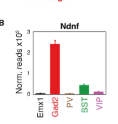
NDNF-Selective Marker for L1 Ins in Neocortex
Usd RNA sequencing from defined subtypes of cortical neurons to express Cre-dependent tagged ribosomal protein
A marker of L1 GABAergic INS must be enriched with the RNA isolated Ga2-Cre from mice
Compared with RNAs purified from cortical excitatory neurons
All three of these account for 85% of INs
Largely absent from L1
NDNF (neruon0derived neurotrophic factor) only gene expressed at appreciable levels
Promising candidate for marking L1 INs

Slide 59
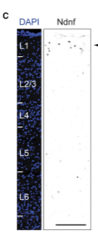
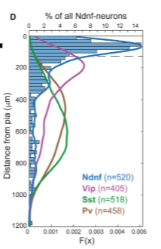
NDNF-Selective Marker for L1 Ins in Neocortex
Fluorescent in situ hybridization showed the NDNF expressing cells are highly concentrated in L1 expression pattern
Differing from well known IN subtypes
Comparing to pan-gabaergic and pan-glutamatergic markers shows that most NDNF cells are GABAgeric
Most do not express Vglut
Shows that NDNF is s apseficif marker of L1 Ins in adult cortex

Slide 60
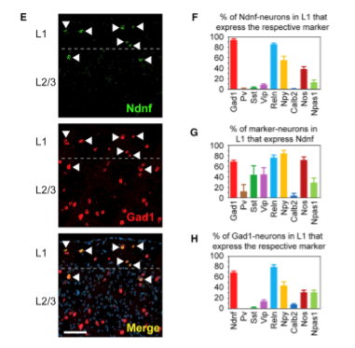
NDNF vs Gad1
Used FISH to compare the xpression of NDNF to Gad1 in IN subtypes
NDNF expressed in 2/3 of all L1 Ins
L1 NDNF-Ins do not overalp with populations such as Pv, Sst, Vip, Calb
L1 NDNF overlaps with Reelin and Neuropeptide Y
Some connection with nNos (expressed in lower cortical layers)
NDNF should be used as the marker for L1
Can be used in/outside of auditory cortex, pre/infralimbic systems, prefrontal cortex

Slide 61
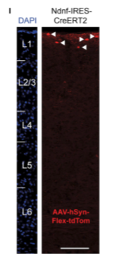
New Mouse Allele
Tamoxifen-inducible version of Cre recombinase
Expressed under NDNF control (Ndnf-Ires-CreErt2)
Drives expression only in presence of tamoxifen when crossed with reporter strain
Shows tight control of Cre activity
Differs from previous studies done with NDNF expression
This line can label blood vessel in the cortex ( with Ai9 reporter)
When used with adeno-associated viral vector (AAV) this line only selects L1 NDNF-IN

Slide 62
Second New Mouse Allele
Flp Recombinase expressed under NDNF locus (Ndnf-Ires-FlpO)
Showed similar selectivity for L1
Similar for labeling NDNF neurons in the Cre line
Shows both lines can be important in circuit dissection
L1 NDNf-Ins are faithfully used by both lines in prefrontal cortex
Allows for specific labeling and manipulation of L1 NDNF-IN in adult cortex

Slide 63
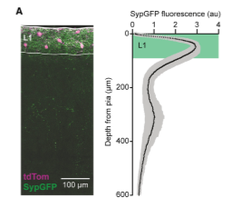
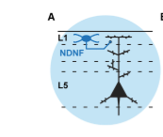
L1 NDNF-Ins Mediate Long-Lasting Inhibition of PN Dendrties
AAV mediated transduction of NDNF-Ires-CreERT2 mice (infused with GFP protein)
Output of INs remains in L1 predominantly
Second Peak at 300 um (from L3-L4)

Slide 64
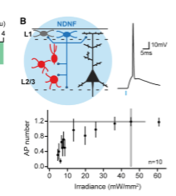
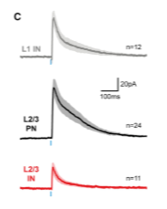
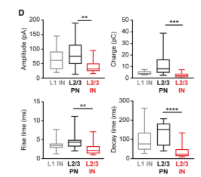
To identify postsynaptic interactions crossed this line (NDNF-Ires-CreERT2) with line labeling inhibitory Ins
AAV mediated expression of ChR-2 (channelrhodopsin) enabled light activation of L1 NDNF-Ins in slices of adult auditory cortex (b)
Inhibited post synaptic current (IPSC) in ChR-2 negative L1 Ins
L2/3 PNs show slow rise and decay time, but kinetics were significantly faster (c-d)
Strongest input shown in L2/3 PNs
L1 NDNF-Ins have important effect could be inhibition of distal PN dendrites within L1

Slide 65
Inputs to L2/3 PNs were observed in optogentic stimulation was restricted to L1 under block of action potential firing (e-f)
Shows distal dendritic inhibition
L1 NDNF-IN output synapses are connected in L1
Display connectivity to other circuit elements
Inhibition of distal PN dendrites as a consequence of L1 NDNF-IN activation

Slide 66
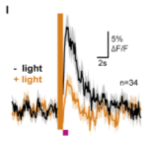
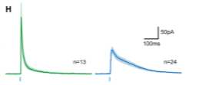
Inhibition in Distal PN Dendrites
Derives from SST positive projections of Martinotti cells to L1
SST-IN inputs have greater amplitudes to L2/3 PNs (i)
Could be due to more efficient optogentic stimulation
L1 NDNF-IN had IPSC with more charge transfer, due to prolonged kinetics (h)

Slide 67
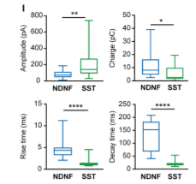
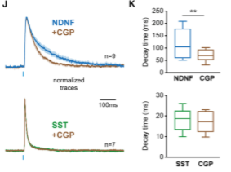
L1 NDNF-IN had slower rise times and onset than SST IPSC (i)
Long decay of L1 NDNF-INs IPSCs could show contribution of GABA receptor antagosint CGP 55845
Reduced decay times of IPCS mediated by L1 NDNF (j/k)
SST Recorded unchanged marked (j/k)
Inhibition from L1 NDNF-INs displayed slower rise and decay time than SSt IPCS (under GABA receptor block)
Indicates additional source for kinetic differnece

Slide 68
Inhibition from two sources controls activity of PN desntrites
Identify L1 NDNF-INs as genetic source of inhibition in PN dendrites
In comparison with SST Martinotti cells (based on kinetics and receptors)
Inhibition from L1 NDNF-INs and SST-Ins could contribute to oscillations in differing frequency bands

Slide 69
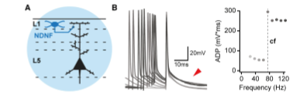
L1 NDNF-Ins Control Activity in PN Dendrites
Second function of L1 Ins may be to vontrol firing of dendritic spikes in distal PN dendrties
Exculsive sensitivity to GABA receptor activation
Used in vitro action potential bursts of increasing frequency
Elicted dendritic spikes in adult auditory cortex

Slide 70
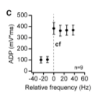
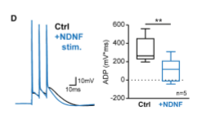
L1 NDNF-Ins Control Activity in PN Dendrites
Afterdepolarization(ADP) of the burst increased in a highly linear fashion (c)
With stimulation frequency
Indicates critical frequency beyond the dendritic spike elicitation
Preceding optogentic activation of L1-NDNF (d)
Strongly reduced ADP supracritical frequencies
Left ADP at subcritical frequencies unaffected
Control of dital dendritic electrogenesis in L1 by NDNF-INs

Slide 71
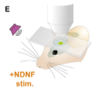
L1 NDNF-INs control over Sensory Response
Do L1 NDNF-INs have control over sensory response in distal PN dendrites?
In an awake animal?
Used in-vivo 2-photon imaging (e)
Used dendritic calcium imaging with optogentic control over NDNF-Ins
To obtain sparse labeling of PNs

Slide 72
Injected retrograde vector carrying Cre recombinase into subcortical targets of auditory cortex in Ndnf-Ires-FlpO mice
Allow selective expression of GCaMP6 (calcium indicator) and tdTomato (motion detection)
Simultaneously, a Flp-dependent AAV was injected in the auditory cortex
Enable expression at optogenetic activator (Chrimson)
Ideal due to use in combination with 2-photon imaging and red shifted excitation spectrum

Slide 73
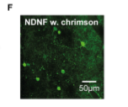
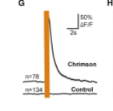
Validation of Methods
Expressed both GCaMP6 and Chrimson in NDNF-Ins (f)
Triggered large calcium transients in Chrimson expressing NDNF-Ins
No detectable response in NDNF-Ins expressing only GCaMP6
Indicates successful optogentic stimulation (g)

Slide 74
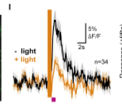
Activity of PN Dendrites in L1
Imaged activity of dendrites in L1 (130 dendrites in 3 mice-H)
Sensory stimulation: 5 white noise bursts, 100 ms duration, 5Hz
Significant responses 34/130 dendritic segments (I)
Preceding optogentic stimulation activation of L1 NDNF-Ins there was a strongly reduced dendritic response (I)
Similar results when taking in to consideration all dendrites

Slide 75
Quick Review: Conclusions
Considering the observation that L1 NDNF-IN output synapses are enriched in L1, where there is direct contact with PN distal dendrites
In combination with previous slide data
Provides thought that there is direct control over dendritic activity by L1 NDNF-Ins in the intact animal
Cannot rule out contribution of somatic inhibition to account for this reduced dendritic activity
Suggests that inhibition from NDNF-Ins control firing of spikes in distal PN dendrites in L1
Inhibition lasted several seconds, consistent with L1 NDNF-IN inhibition in slice recordings
Larger responses were more strongly suppressed by NDNF-IN input

Slide 76
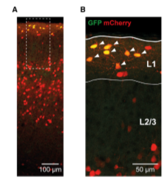
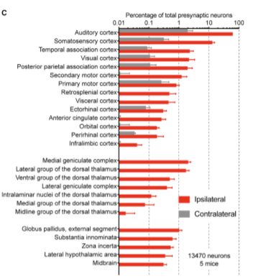
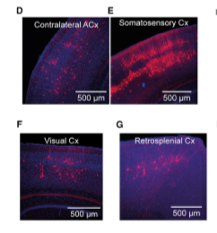
Sources of Synaptic Input to Auditory Cortex L1 NDNF-INs
What are the brain wide synaptic inputs do these cells?
Used monosynaptic restricted tracing: modified rabies viral vectors
Starter target cells targeted by AAV injection in Ndnf-Ires-CreERT2 were highly enriched in auditory cortex L1 (A, B)
Found in local auditory cortex and other brain areas (both ipsi and contralaterally) (c-h)

Slide 77
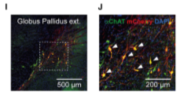
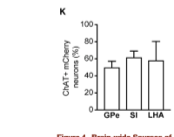
Range of cortical feedback projections from sensory areas
Sensory:Somatosensory, visual
Motor Areas: primary, secondary
Association Areas: retrosplenial, temporal assocaitaion
Frontal Areas: anterior cingulate, infralimbic
Thalamic nuclei supply input to auditory cortex L1 NDNF-Ins
Includes medial geniculate nucleus, dorsal thalamus
Larger Brain Areas are noted
Areas that contain cholingeric neurons
Globus pallidus externus, substansia innominate
Performed an antibody staining for choline acetyl transferase (ChAT) and found half of presynaptic neurons are cholingeric (I-K)

Slide 78
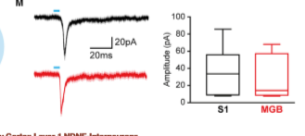
Performed anterograde, physiological validation on strongest cortical input from outside of auditory cortex and strongest thalamic afferent connection
To ensure monosynaptic connection of rabies vector
Used somatosensory cortex and medial geniculate body
In vitro recording showed monosynaptic connections in both (m)
Shows connection but postsynaptic current an vary based on experimental factors
Not likely true strength of connection measured
Overall, shows L1 NDNF-Ins receive input from larger range of brain area
Encode contextual, top-down information
Suggest that activity of L1 NDNF-Ins may be controlled by internally generated signals, such as the ones that occur during memory expression

Slide 79
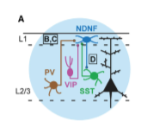
Inhibitory Control of L1 NDNF-IN
Inhibitory input from other Ins can shape activity/function of other Ins
Crossed Cre lines for SST, VIP, PV (A)
To mice expressing EGFP under NDNF promoter
To determine local inhibitory inputs to L1 NDNF-Ins
Cre Dependent Expression of ChR-2 created reliable acitivation od differing IN in auditory cortex slices

Slide 80
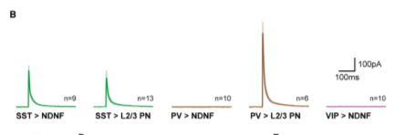
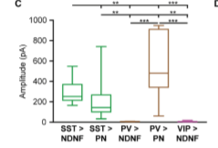
Recordings performed from L1 NDNF-Ins and neighboring L2/3 PNs (B/C)
Activation of both SST and PV Ins elicited large IPSC in the PNs
Faster rise times and onset latencies for PV input
Similar recordings from L1 NDNF showed no measurable inhibition from with PV or VIP populations
Strong input from SST Ins (B/C)
Strength of input equal to the measured in neighboring L2/3
Measure by amplitude and charge transfer
SST Ins only source of inhibition in L1 NDNF-INS

Slide 81
SST Ins only source of inhibition in L1 NDNF-INS
Is this interaction reciprocal?
Used cross SSt-Ires-Cre and NDNF-Ires-FlpO mice
TdTomato expressed in SST-Ins
Chrimson expressed in L1 NDNF-Ins
Optogentic stimulation showed IPSC in SST-INS, meaning there is bidirectional communication (D)
Inhibition from NDNF to SST Ins was weaker (d)
Was not due to stimulation efficacy
Indicates unidirectional information flow from SST-Ins to L1 NDNF-Ins

Slide 82
Is inhibition from SST Martinotti cells a dominant factor controlling sensory response of L1 NDNF-Ins in the intact circuit?
Used in vivo 2 photon calcium imaging in auditory cortex of awake mice
Considered that increased isual stimuli increased size of recruitment of response of SST-Ins
Simultaneously presented trains of auditory stimuli
Increasing in sound pressure levels (e)

Slide 83
To target output of Martinotti cells
Imaged axons of SST-Ins in L1 using GCaMP6
Showed stimuli of increasing intensity recruit stronger responses of SST_IN axons in L1 (F-H)
This form of inhibition is proportional to activity of local PN network (same as visual system)
Similar experiments in L2/3 produced similar results
Indicates validity of imaging approach
Suggest that axonal calcium response are directly related to inhibitory transmission from SST-INs

Slide 84
L1 NDNF and SST Control
To test if L1-NDNF is under tight control of SST-Ins
Combined Flp-mediated expression of GCaMP6 in L1 NDNF-Ins with Cre-dependent expression of tetanus toxin in SSt-Ins
Silences selective output of these cells
In contrast to control, there was no noticeable inhibition in L1 with high intensity stimulation
Data indicates that L1-NDNf may be under tight control of SST-INs
In awake auditory cortex
Shows that SST can override NDNF input by replacing input to the pyramidal cells

Slide 85
Learning related Plasticity of Sensory Responses in L1 NDNF-Ins
Used associative auditory fear conditioning
Allowed for retrieval of the same L1 NDNF-Ins during CS is neutral and during memory retrieval
Used freezing and pupil dilation (positive correlation) to show successful memory acquisition and to examine fear
Greater pupil response after fear learning
Shows successful fear memory retrieval in the mouse

Slide 87
Habituation
L1 NDNF-Ins responded similarly across the neurons with CS
30% strongly activated
Small fraction inhibited
Same cells after fear conditioning
Increased response during fear memory expression
Shows recall of an traumatic memory can increase L1 NDNF-IN response

Slide 88
Similar experiment with SST axons
Changes level of dendritic inhibition also
SST axons are completely unaffected by fear memory expression
Net inhibition is stable from this source
Combines with L1-NDNF to perform distinct function of fear memory expression

Slide 89
Conclusions
Inhibition of Martinotti cells remains unchanged after conditioning
Tightly control sensory response in NDNF-Ins
Shows genetically dependent form of dendritic inhibition
Highly experience dependent
Salient stimuli are encoded at elevated levels of distal dendritic inhibition
Along with disinhibition
L1 NDNF-Ins strong source of inhibition of distal PN dendrites
Differs from SST, but is complementary
Have slow time course and strong GABA receptor contribution
Probably located in neocortex
Recruited by cholinergic input and top down afferent inputs

Slide 90
Conclusions
NDNF is a highly selective marker of INs in adult auditory and prefrontal cortex
Is the L1 NDNF-Ins in the prefrontal cortex also?
Generate genetic responses to target these nerons (tamoxifen-inducible Cre allele, Flp allele)
Auditory Cortex has a prominent interaction with L1 NDNF Ins
Strong interaction with SST-Ins (in vivo and in vitro)
Induce Auditory Cortex plasticity by associate fear condition
Based on L1 NDNF and SST-In responses of expression during behavioral memory
L1 NDNF response is related to fear memory

Slide 91
Conclusions
SST Inhibition dominates in conditions of weak and imprecise stimulus encoding in PNs
L1 NDNF-INs occurs when sensory input is relevant to the animal

Slide 92
Summary-Overall
Ca1 connection is reduced in the hippocampus
This disrupts generalization
No fearful response
In the neocortex
L1 NDNF is increased when a fearful memory is recalled
Inhibition of these, or use of SST cells, means the expression of fear memory is not as relevant to the animal
In auditory cortex to the amygdala
Discriminative fear conditioning prevents habituation from occurring
Possibly by SOM cells
Discriminates between valued or irrelevant information

Slide 93
Clinical Application
Entire system works to decide what is relevant
Changing how the brain processes relevant could be something to look at for clinical treatment
Reducing Ca1 to inhibit generalization could be a clinical application
Can use L1 NDNF-IN for a diagnosis piece
Would have to be noninvasive
Targeting specific neurons can alter activity of these neurons instead of others
Gene therapy through neural gene transfection

